Slide 1
Sample算法 - system_labels
以下內容為一個sample
"e16ea6a3c00b40cdbd5899b735ce71e4": {
"id": "e16ea6a3c00b40cdbd5899b735ce71e4",
"auditd_events": {
"start": [
"360240",
"360241",
"360242",
"360243"
]
},
"technique": "T1018: Remote System Discovery"
},
Sample的id
Sample所在的機器
Event的id 內容存放在 Cache/Syslogs/"team"/audit.log 裡
該Sample所屬的TTP

Slide 2
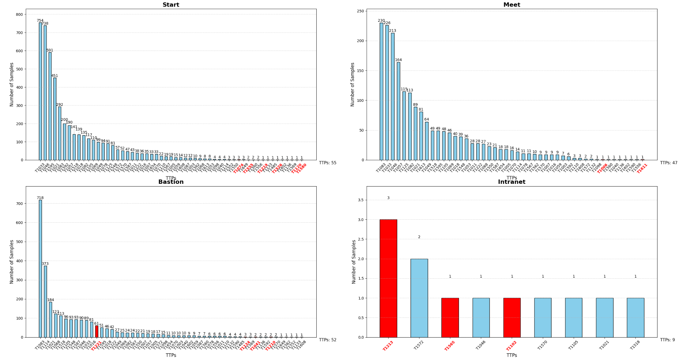
Notes:
show sample算法
哪些TTP兩個機器
哪些TTP會跟網路連結

Slide 3
跨機器的TTP
TTP 編號 | 描述 (參考) | 出現次數
T1033 | System Owner/User Discovery | 12
T1021 | Remote Services | 7
T1572 | Protocol Tunneling | 5
T1082 | System Information Discovery | 3
T1049 | System Network Connections Discovery | 3
T1046 | Network Service Discovery | 2
T1110 | Brute Force | 2
T1083 | File and Directory Discovery | 2
T1057 | Process Discovery | 1
T1592 | Gather Victim Host Information | 1
T1018 | Remote System Discovery | 1
T1595 | Active Scanning | 1
T1587 | Develop Capabilities | 1
T1003 | OS Credential Dumping | 1
T1556 | Modify Authentication Process | 1

Slide 4
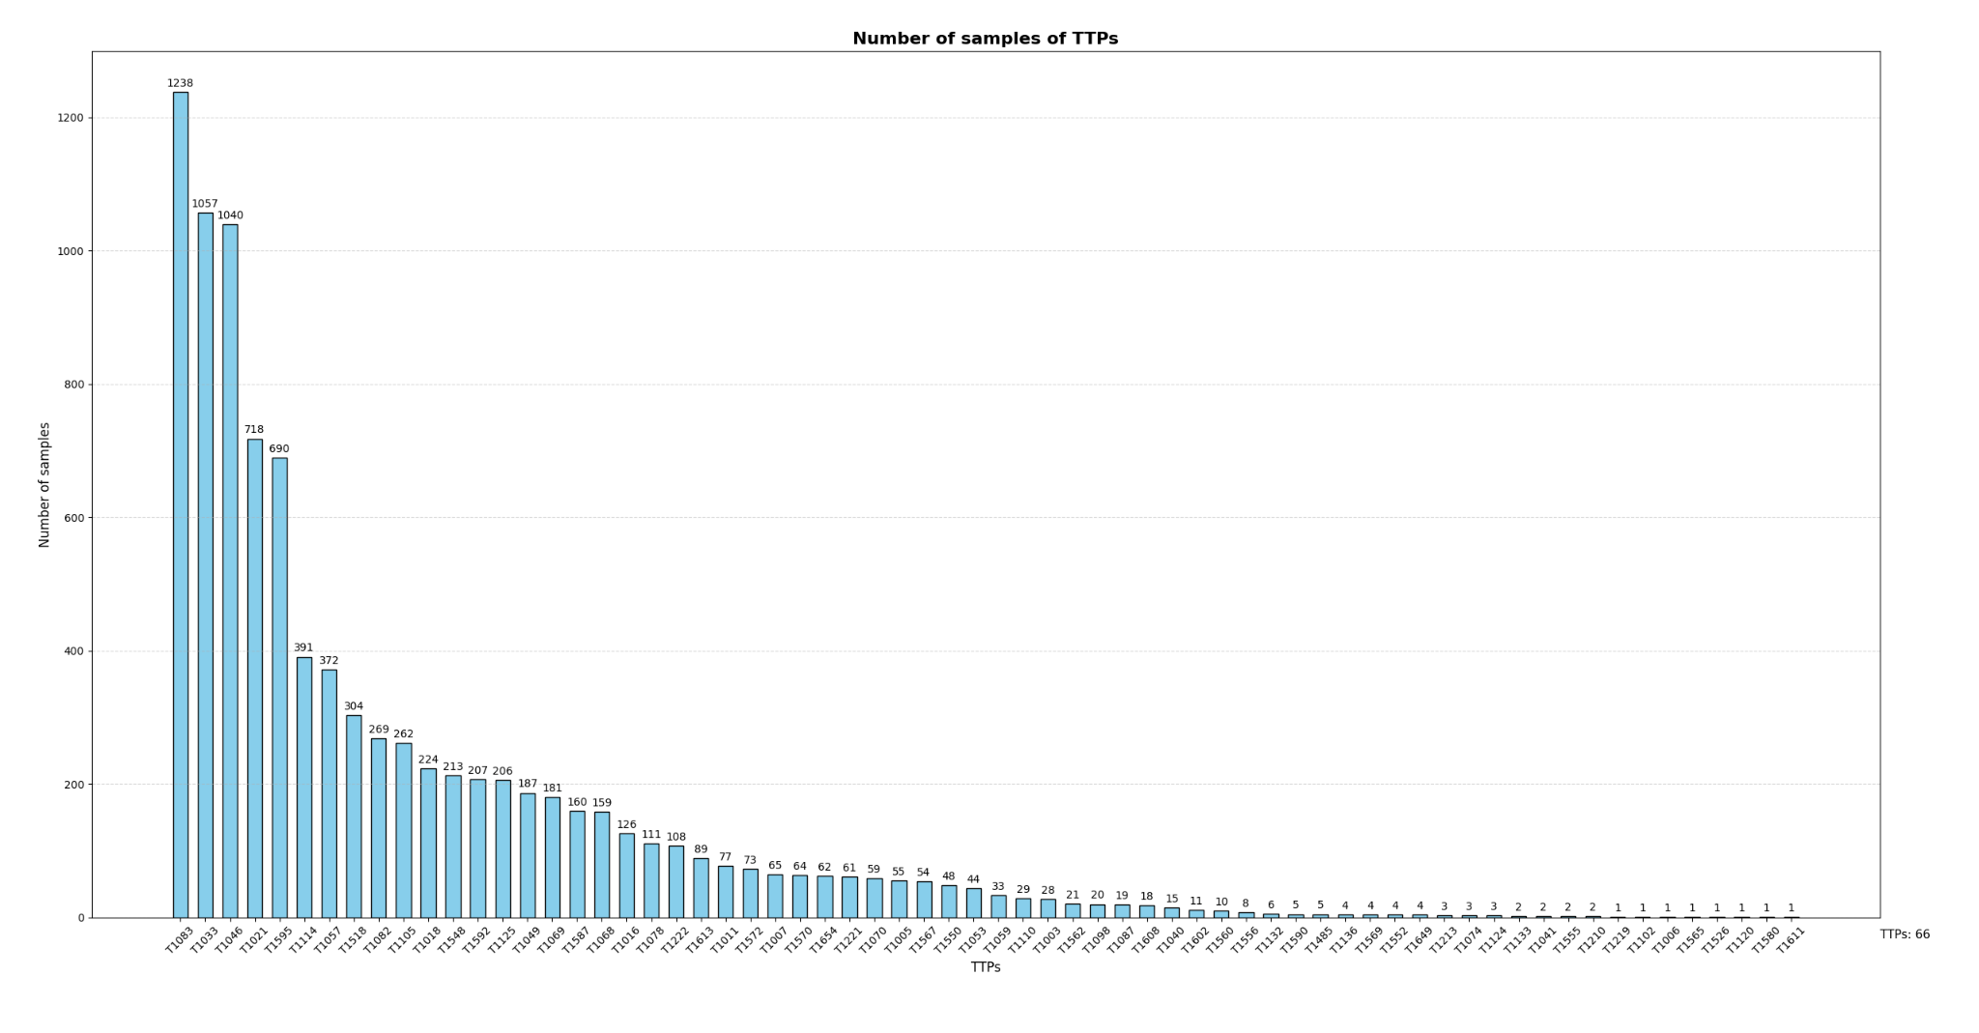

Slide 5
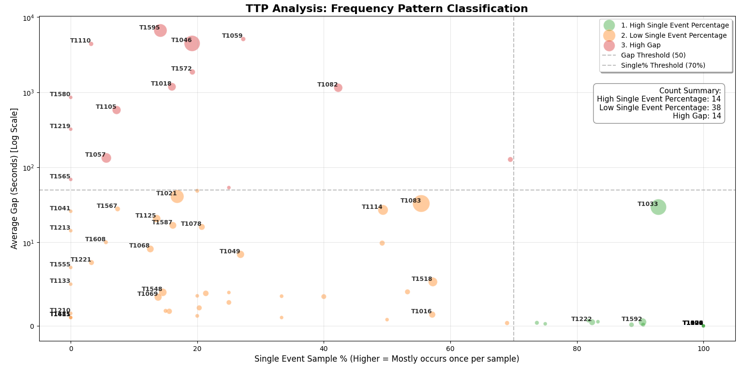

Slide 6
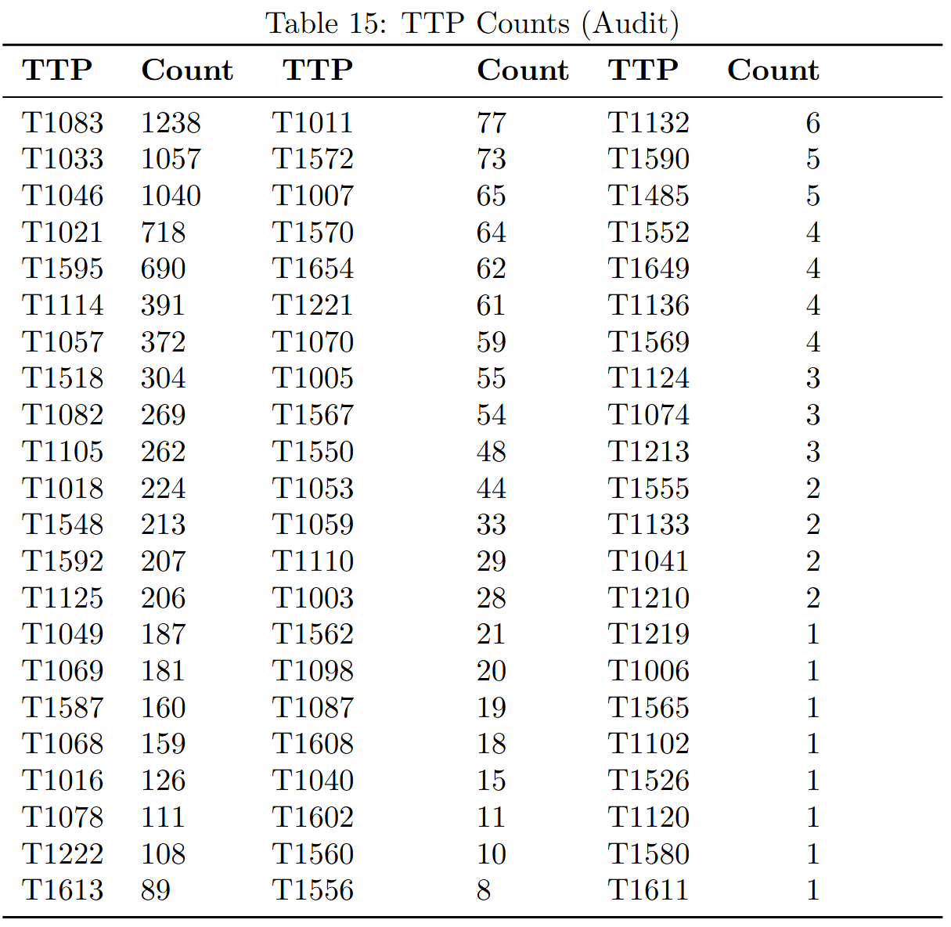
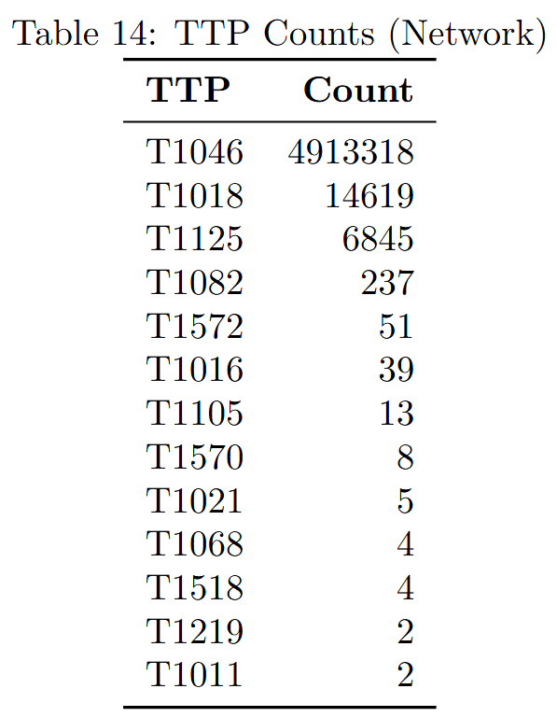
Statistic of TTPs - 66TTPs
Linked events
Total benign processes: 404,637
Total malicious processes: 9,243
Total benign events: 32,365,532
Total malicious events: 62,609,868
Notes:
看T1011 了解一下audit -> network的過程
是否要看network log才能觀察attack

